Slide 1


Data Protection Update
2023
Rebekah Fozzard
Manager – Special Projects and Data Protection Officer
Representative Church Body, Church House
Rebekah.fozzard@rcbdub.org / dataprotection@rcbdub.org
00353-1-4125660

Slide 2
What is data protection?
Data protection law is concerned with the protection of the personal data of living individuals
Our data protection rights and obligations are governed primarily by the General Data Protection Regulation and the Data Protection Act 2018
Personal data is any information which relates to an identified or identifiable individual

Slide 3
Exemptions
The GDPR does not apply to an organisation which does not operate within the EU, where an organisation does not process personal data, or where an individual processes personal data in the course of a purely personal or household activity (the ‘household exemption’)
This household exemption relates to the processing of personal data which has no connection to a professional or commercial activity. The household exemption also applies to an individual keeping an address book and personal correspondence

Slide 4
The Buzz words!
Data Subject: you / me / any natural living persons
Data Controller: a person, agency or other body which, alone or jointly with others, determines the purposes and means of the processing personal data. e.g. the Parish
Data Processor: the person/body that processes personal data on behalf of the controller
Processing is anything that is done to or with a person's data. Includes collecting, recording, keeping, disclosing, publishing, using or deleting data
Special category personal data needs extra protection:
  Personal data revealing racial or ethnic origin, political opinions, religious or philosophical beliefs or trade union membership;
  Genetic data and biometric data processed for the purpose of uniquely identifying a natural person;
  Data concerning health
  Data concerning an individual’s sex life or sexual orientation
Notes:
It is interpreted broadly and covers a much broader range of information (e.g. beyond an individual’s name, address, contact details, etc.) than some people might expect.
Data Controller: e.g. an employer in relation to their employee’s data, a GP in relation to their patient’s data, etc.).
Data Processor: e.g. a payroll service provider that manages payments to employees on behalf of an employer, or a call centre taking calls on behalf of a charity).
Under Data Protection Law, special categories of personal data are subject to additional protection.

Slide 5
The rules we need to follow
Personal data must be:
Fairly obtained
Processed lawfully, fairly and transparently
Only used for the specific purpose you received permission for, and no other purpose
Is adequate, relevant and limited
Is accurate and kept up to date
Is only stored for as long as is necessary
Is kept safe and secure to protect it
The controller is legally responsible for and must be able to demonstrate compliance with data protection law
Notes:
Lawfully, fairly, transparently - happy for the person whose data is it to see you using it in this way – e.g. if I give my personal details for Gift Aid purposes, that is what it is being used for
What is the specific purpose you have this data for? - Need to know only – don’t ask for information you do not need.. if you are running the crèche in church, you need a telephone number of a parent to use in an emergency – this is fine; once you don’t share it
c) Adequate, relevant and limited – ensure the information you have is relevant and limited to what you need it for; no more. For example; question – why you might need a date of birth? Or a PPS number
d) Kept up to date
e) Stored for as long as is necessary - Once the child leaves the crèche you delete the record with the parents number
f) Safe & Secure = Only people who need to see this information can access it; passwords are in place; locked storage etc. Document your procedures
No keeping data ‘just in case’ – Retention policy - data should only be kept for as long as is necessary and useful. You should not hold personal information indefinitely unless there is a valid reason to do this
Also, you do not need both a hard copy and soft copy of personal information - in most cases a soft copy will suffice. This means you can get rid of many of your hard copy files. However, it is good to keep hard copies of files with signatures. While the Electronic Commerce Act 2000 removes evidentiary distinctions between paper and electronic records; a real signature for banking and finance purposes; as well as HR contract purposes is best practice
For example,. Health & Safety records should be kept for 10 years from date of an accident – according to the Safety, Health and Welfare at work regulations 1993
Child protection case files- kept indefinitely – archive Baptism, marriage, burial and confirmation registers – keep indefinitely and archive

Slide 6
What does ‘processed lawfully, fairly and transparently’ mean?
Consent
Legitimate Interest
Contractual Necessity
Compliance with Legal Obligation
Public Interest
Vital Interest
Notes:
Contractual Necessity - personal data may be processed if the processing is necessary in order to enter into or perform a contract with the data subject. E.g. employee contract; upgrading the church organ you will have a contract for the person doing it
Compliance with legal obligation – personal data may be processed if the controller is legally required to perform such processing (e.g. complying with the constitution of the Church of Ireland; reporting of gender pay data for the CSO etc.)
Vital Interests – personal data may be processed to protect the vital interests of the data subject. E.g. in a life or death situation it is permissible to use a person’s medical or emergency contact information without their consent.
Public Interest – Life/Death Personal data may be processed if the processing is necessary for the performance of tasks carried out by a public authority or private organisation acting the public interest
Processing Sensitive Personal Data - (GDPR calls special category data) means information about a person’s racial or ethnic origin; political opinions, religious or similar beliefs, physical or mental health, sexual life, criminal history, biometric data etc. To process this information you need extra permission including:
Explicit consent from the data subject or inline with Employment Law – necessary for employment law or social protection reasons or Data has already been made public
Processing personal data about Children - Under GDPR parental consent will be required for the processing of personal data for children under the age of 16.. You must be able to show that you have collected and been given this consent lawfully and therefore, when collecting children’s data, you must make sure that your privacy/data protection notice is written in a language that children can understand and copies of consents must be kept. This should be kept until the young person is 21 and can then be destroyed.
CCTV - -you need to have adequate signage in place so that people know there is CCTV and why

Slide 7
  indication of the data subject’s wishes,
  by a statement or by a clear affirmative action, agreeing to the processing of their personal data
Consent must be
  freely given
  specific
  informed
  unambiguous
  can be withdrawn
Legitimate Interest: Not-for Profit organisations can process special category personal data in the course of their legitimate activities once there are appropriate safeguards in place, and the processing relates only to members, past members or those in regular contact with the organisation in connection with its activities.
Notes:
Consent means permission to use peoples data. This permission needs to be recorded. We have consent form templates on our website to help you in this regard
Where you chose consent to process any personal data you need to remember that consent must be freely given, specific, informed, unambiguous and able to be withdrawn at any time
You will need to record how and when the consent was obtained (and reviewed over time)
As consent for most church activity is sensitive, relates to a religious belief, you need to get explicit consent.
Consent will require clear affirmative action
Silence, pre-ticked boxes, inactivity or a history of processing without complaints will not constitute consent
EG You need to get permission to use peoples photos photographs on your website; in your parish / diocesan magazine; the gazette You need to be especially careful with children’s data
you should not publish names and addresses without permission
Old consent – can we use it?
You should review any existing consents you have on record to check whether they comply with the stricter rules under GDPR
The basic rule is that if consent was obtained using an opt out box or is ambiguous you can not rely on it after 25th May
Freely given
e.g. entering into a contract or receiving a service should not be ‘tied’ to the user giving consent to the processing of data which is not necessary for the service to be delivered.
E.g. I cant be told that I can not attend bereavement counselling in my church because I didn’t want to give you my PPS number. You don’t need my PPS number for this service.

Slide 8
The rights of data subjects
  BE INFORMED
  ACCESS their personal information
  Have personal data CORRECTED
  Have personal data ERASED
  RESTRICT processing
  OBJECT
  Data PORTABILITY
  No AUTOMATED decision making
Notes:
Be informed about what their data is being used for – e.g. I am using your personal information as it is required for HR purposes (payroll)
Have access their personal information within 30 days of requesting it
Have personal data erased (the right to be forgotten) (Please delete my records – exception in a Disciplinary case )
Have personal data corrected – e.g. name is wrong; must be corrected etc.
Restrict processing (decide what their data can be used for; so no phone number and event cancelled, I can’t contact you) – don’t delete but don’t use
Object to their data being processed (exemption – HR in work) – please do not use my photograph in the parish magazine; on the website
Data portability (have their data sent, online, to a third party)
No automated decision making ( human intervention required) – e.g. going for a mortgage

Slide 9
Right to be informed
The data controller (e.g. Diocese, Parish) must provide the data subject (the individual) with:
Contact details of controller
Info. on purpose of processing
Legal basis relied upon
Who data has been shared with
Retention period
Existence of rights
Right to make a complaint

Slide 10
The right of access
Individual entitled to know
If data is being processed
Type of information held
The data controller must
Respond without delay and within one month
Who it has been shared with
Retention period
Existence of rights
Purpose of processing
Verify identification
No fee can be charged
Provide data in a form that is concise and clear
Include ALL personal data – PC, Phone, Email, CCTV etc.
Watch out for personal data pertaining to others

Slide 11
The right to erasure (be forgotten)
Right to have data erased if:
Data no longer needed for the purpose it was collected
Denied if processing necessary for:
Exercising the right of freedom, expression and information
Consent is withdrawn
Object to processing and no reason this can’t be respected
Unlawful processing
Compliance with a legal obligation
Archiving purposes
Establishment, exercise or defence of legal claims

Slide 12
Other data subject rights
Right to rectification if there is an error
Right to data portability where data is carried out by automated means
Right to object
Right to restrict: limited the way data is used
Rights in relation to automated decision making – right to obtain human intervention

Slide 13
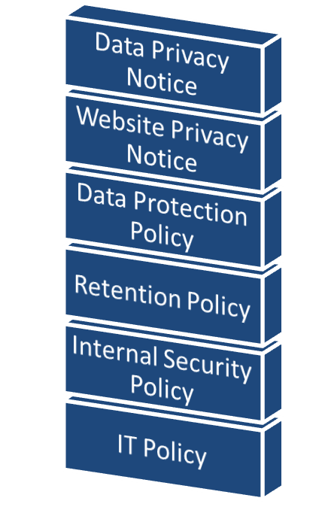
The data controller
Legally responsible for how and why personal data is processed and should:
Instruct data processors, provide training and support
Implement technical and organisational measures
Comply with principles and document how
Keep records on the type of personal data and reason for processing

Slide 14
Managing a Data Breach
What is a personal data breach? accidental or unlawful destruction, loss, alteration, unauthorised disclosure of, or access to personal data
Can include: Sharing without permission; losing data; deleting data in error; stolen data; changing passwords without permission
What to do: What to report:
1. Identify the breach
2. Analyse how serious it is
3. Contain the breach
4. Respond to the breach
5. Identify Lessons Learnt
6. Keep records
DPC / ICO: only breaches which are likely ‘to result in a risk for the rights and freedoms of individuals’ need to be reported. Deadline is 72 hours from becoming aware
Data Subject: must be given ‘without undue delay’, where an incident can expose the rights and freedoms of the data subject to risk. Certain encryption/pseudonymisation may prevent having to notify e.g. where a device containing personal data is lost/stolen, but the device is encrypted, the data is safe and no reporting is needed
Notes:
Organisations will be regulated by the Data Protection Authority where they have their main establishment. As our head office is in Dublin we will be supervised by the Irish Data Protection Commissioner
E.g. passport – retirement group going on a visit to the holy land
Preventing a breach:
Passwords
Limited access
Lock filing cabinets
Encryption

Slide 15

Fundraising
The parish would like to send fundraising material to individuals who have donated in the past and have not previously objected to receiving fundraising material
The purpose of this ‘call’ to seek funds is a legitimate interest
Agreed that it is necessary to process contact details for this purpose, and that the mailing / email is a proportionate way
Considers the balancing test and agrees to just use names and addresses, and it would be reasonable for these individuals to expect that they may receive this material by post
Determines the impact of a fundraising mailing on these individuals is likely to be minimal
The parish includes details in the mailing (and each subsequent one) about how individuals can opt out of receiving postal or emails in future

Slide 16
Photography
Photographs should be treated the same as any other personal data
Be Transparent and Open
  Display notices at events
  Make public announcements
  Get permission before taking / using / publishing / sharing a photo where a person is clearly identified
  Permission (CONSENT) is ALWAYS required to take photos of children and adults at risk

Slide 17
Live streaming
Ensure children or young people are safeguarded whilst a service or event is being livestreamed
Ensure that no children can be identified without the permission of their parents / guardians, or if there are legal reasons why their attendance cannot be identified
Ensure that adults have the choice whether to be seen on camera
CONSIDER:-
Who is going to be involved in the service?
Are there going to be children taking part in the service?
Are there any additional vulnerabilities that might make it hard for some to attend a service because it is being filmed?
Do those involved in the filming and uploading understand the practical measures that are needed to safeguard people online?
What needs to be done to ensure that everyone attending in person is aware that the service / activity is being filmed and streamed?

Slide 18
Safe streaming
Position cameras in such a way as to avoid capturing the images of those in the wider congregation
Provide information about the streaming in advance, to enable people decide to opt out or to sit in a designated area where they will not be filmed
Notices should be placed in a prominent place at the entrance, and consider the newsletter/notice/website to explain services will be streamed
A reminder should be given from the front at the start of the service
Particular care should be taken in relation to children or adults at risk, unless prior consent from them or their parents/guardians has been obtained
Take the following steps:
Create a clear delineation between the areas covered by the camera and areas which are not
Ensure that attendees know that they may be caught on camera when sitting in the designated area and that by sitting in those areas they are consenting to being filmed
Ensure that those who do not consent to being filmed know where to sit
Pan cameras when communion taking place, children’s events etc.
Get consent from the choir, organist and others who will be streamed

Slide 19

Suggested template:
Welcome to the parish of …………………..
This service is being live streamed / recorded* and you may appear on camera if you sit in this area. If you do not consent to being filmed, then please ensure that you are sitting outside of the filming zone. Please speak to one of the church wardens if you are unsure of what to do or require further information. Thank you

Slide 20
Keeping online meetings safe
Access
Ensure access by invitation only
Recording – if you are planning to record a meeting/event
Any speakers need to give consent to being recorded prior to the meeting
Permission
Sharing of files amongst attendees should not be permitted.
Unique meeting ID’s and passwords will be required to access the event
The meeting ID’s & passwords will should not be advertised publicly (to avoid Zoom bombing)
Participants should not be able to join the session before the meeting facilitator. Instead, they will remain in a waiting room until access is granted by the facilitator
Only authenticated users can join meetings
Recordings can be managed by the meeting facilitator and attendees are informed
The recording will end when the meeting is finished
Any guest speakers’ recorded pieces may be shared if permission received
It is possible to ensure attendees to bigger events are muted throughout the recording and are not visible
Chat history and call transcripts should not be saved
All participants can be muted with cameras ‘off’ upon entering the session
After the event, Zoom will share any recordings to the organizer. This should be password protect and kept only for as long as necessary
Don’t let people in if you don’t know who they are

Slide 21
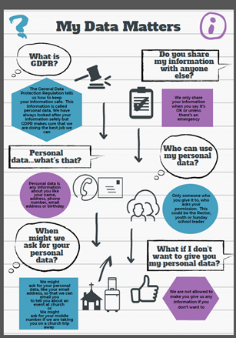
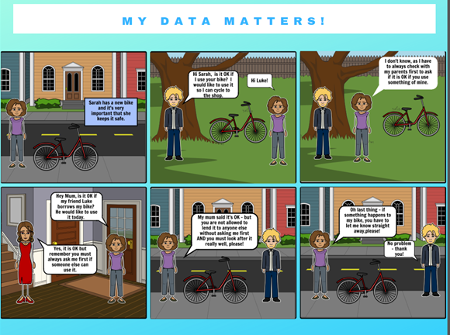
GDPR and Safeguarding
Protect sensitive personal data and have appropriate safeguards in place
Ensure you knows their roles and responsibilities
Develop clear privacy notices for children and adults at risk
Follow the Retention guidelines
www.gdpr4schools.ie
Notes:
SV – select vestry
DP – Diocesan Panel

Slide 22
Security Starts With You!
Technology
Procedures
People
Awareness Training
Governance
Resources
Acceptable Use Policy
Data Classification
Password Policy
Incident Response
Anti Virus
Incident detection
Encryption
Network Monitoring
Strong Password and Strong PINs
Watch out for Phishing
Protect your office space – tidy desk; lock your cupboards/door;
Shred confidential documents
Develop a security routine – e.g. Lock your Screen; Be suspicious!
Notes:
Protect your devise – lock your computer; strong pins

Slide 23
In Conclusion
1. Agree who is in charge
Who is responsible for data protection in your parish?
2. Become Accountable
3. Develop processes, procedures and notices
4. Communicate
Review ALL personal data you hold
Data Privacy Notice
Poster on your notice board
Document how you did your review
Communicate via parish magazines etc.
Parish Retention Policy
Procedure on how you get consent
Download the GDPR checklist from the RCB website
Procedure on what to do if a data breach
Update parishioners
Notes:
Agree who is in charge - The rector and another member of the parish should take responsibility for compliance
Becoming accountable - making an inventory of all the personal data we hold; why we hold it and who we share it with
Document your findings – as this is a record of compliance Check you have documented procedures for ALL activity with personal data
Developing Processes, Procedures and notices
Ensuring your procedures cover ALL the rights individuals are entitled to
Identify and document your lawful basis for processing data
Plan how you will handle requests for personal data
Develop a data privacy notice – tell people in a clear, easy to understand way, how you intend to use their data. How long you will keep data for and what lawful basis you have to process data.
CCTV – inform people what it is used for and ensure you have correct signage
Build in extra protection for children – you will have to have a policy in place saying how you get consent from a parent or guardian if a child is under 16. You need to be able to verify that the person giving consent on behalf of a child is allowed to do so.
Data Sharing – be sure you are allowed to share information with others and make sure it is kept safe when shared
Know what to do if there is a data breach
Communications Train staff on information governance Ensure your Select Vestry, Church administrators, rectors and other key data users know the law is changing. Support attendance at local training events
Build data protection into your new projects

Slide 24

Thanks for listening
Questions?
Contact me: rebekah.fozzard@rcbdub.org
00353-1-4125660

